Slide 1
Week Four

Slide 2
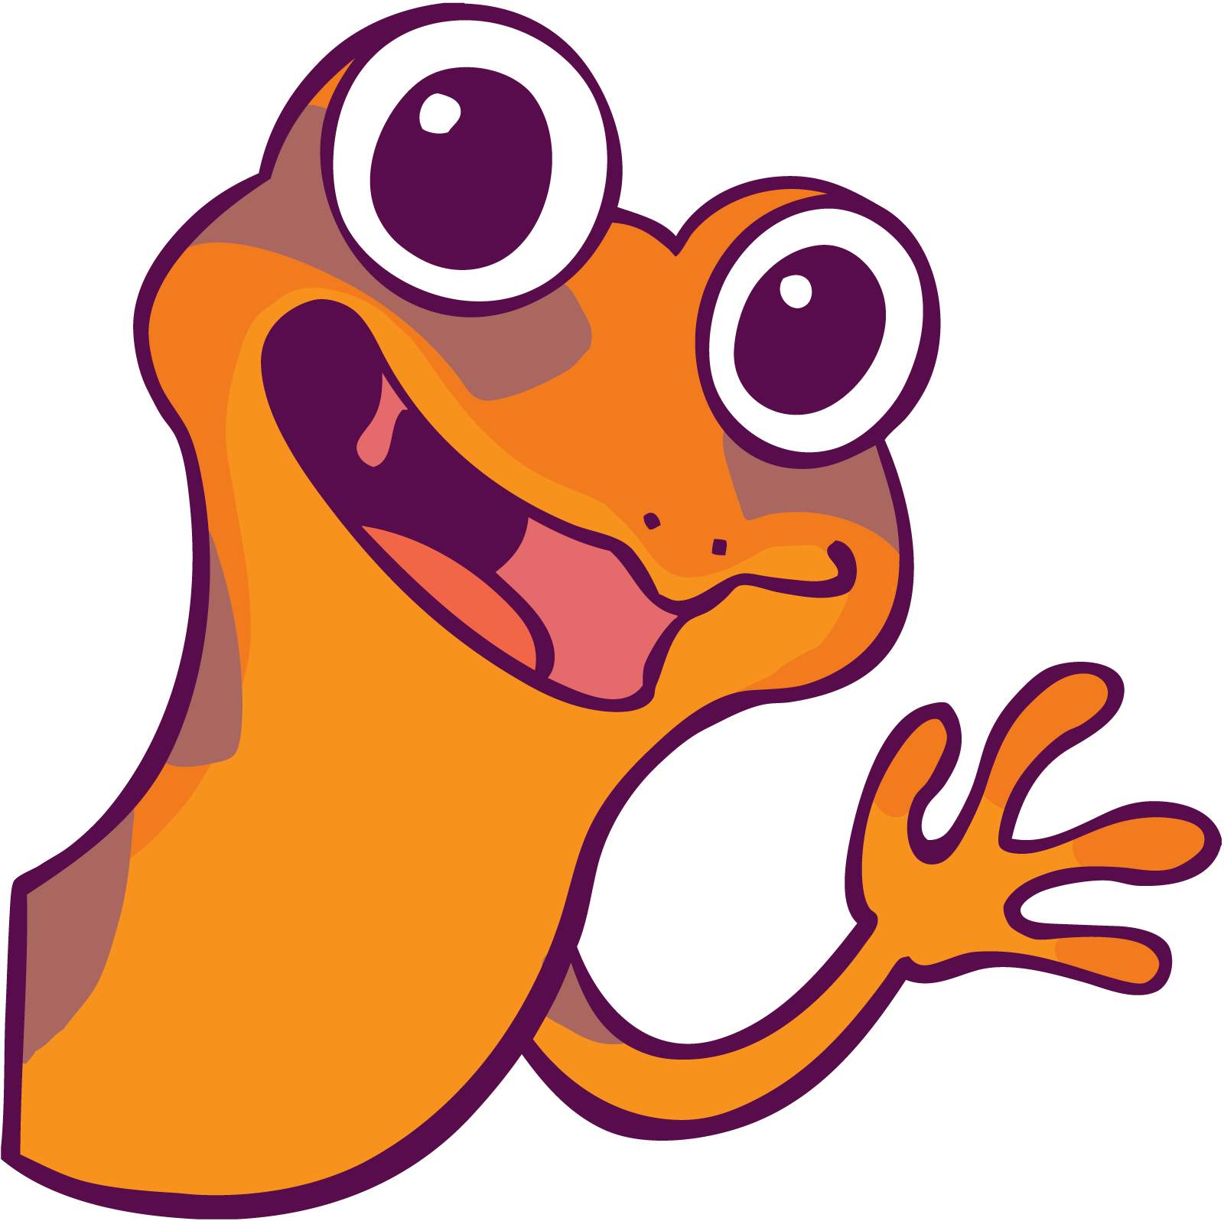
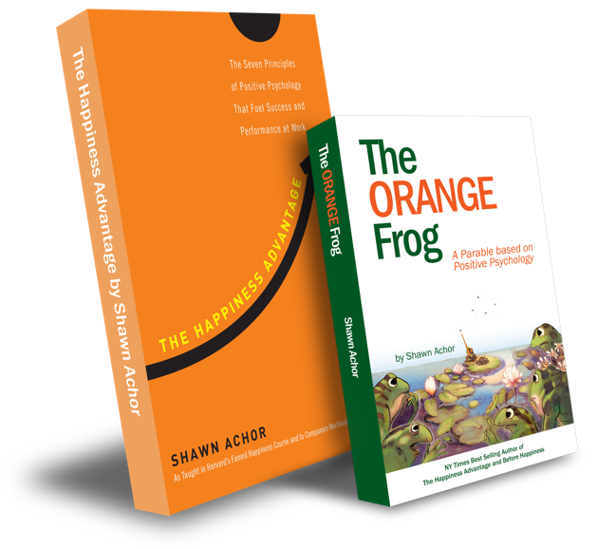
The Orange Frog
Gratitudes
Week 4
Reflection and Gratefully Moving Forward
By Shawn Achor

Slide 3
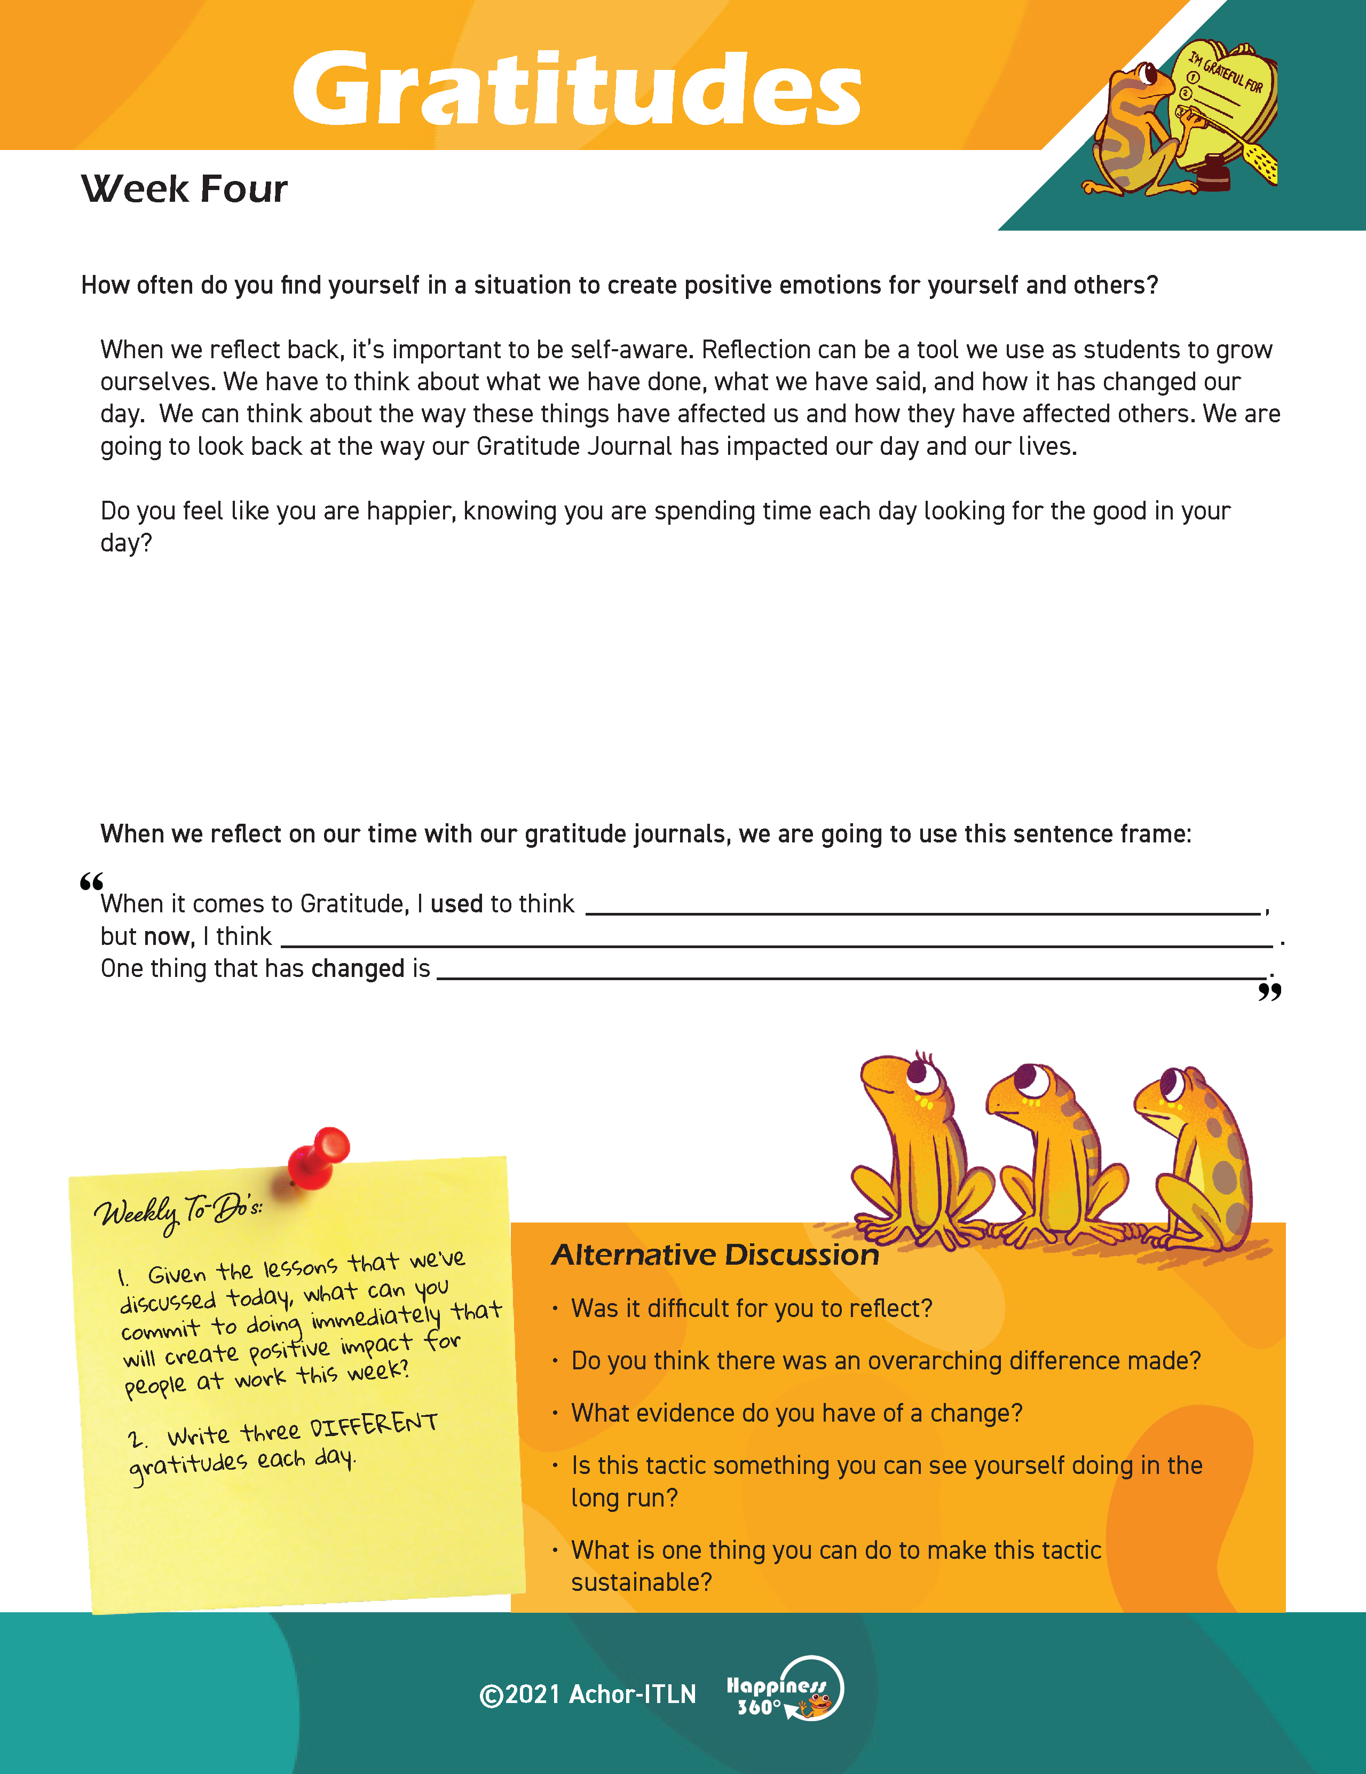
Each week, you’ll find a Worksheet in the resources section of the website and your Gratitude Journal.
Please, have those available.
\

Slide 4
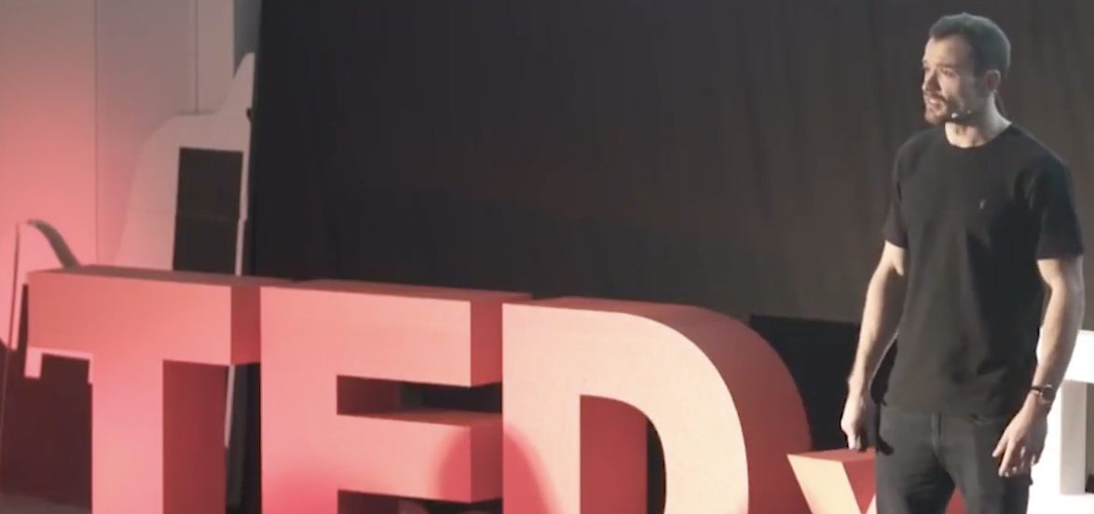
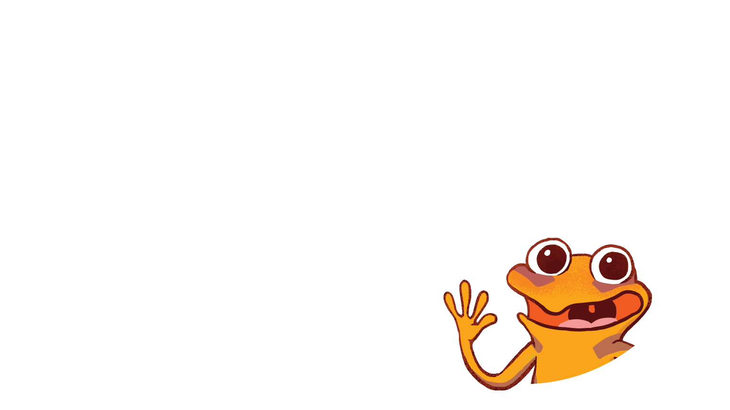
Did you get a chance to watch the video from Motivation Ampire on building positive habits in 21 days?
Prework
Expectations
Have you finished your 21-day Gratitude Journal? (Have it ready.)

Slide 5
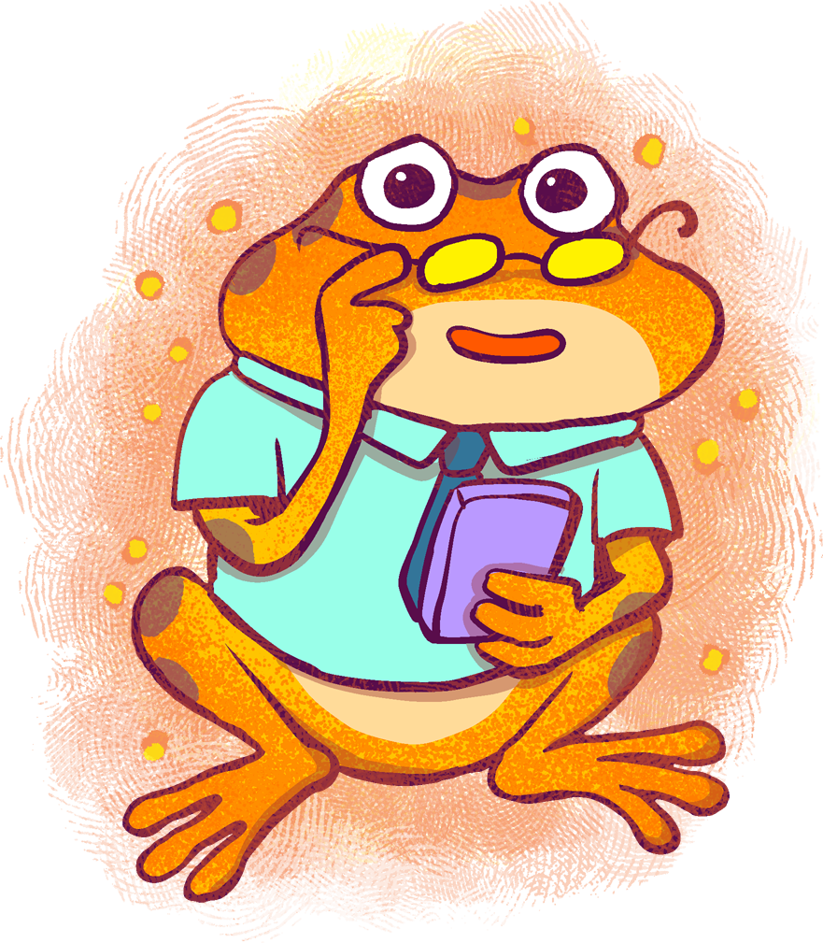
Gratitudes
Learning Objective: (“Each participant…”)
Can reflect back on my 21 day challenge and determine the importance of the “Gratitude Tactic”
Will discuss the importance of being able to look back and decide where the tactic had an impact on my life or not
Notes:
Standard:
Essential Concept and/or Skill: Communicate and work productively with others emphasizing collaboration and cultural awareness to produce quality work.
Interact positively as a team member.
Cooperate with others in a group setting.
Generate ideas with group members.
Are active listeners.
Read and understand information in a variety of forms.
Express ideas.
Skill:
Active listening, express ideas
Allow Spark to read pages 13-18 for the students or read to them.
https://www.orangefrogschools.com/elementary/ofkidsbook

Slide 6
Essential Concept
Demonstrate leadership, integrity, ethical behavior, and social responsibility in all environments.

Slide 7
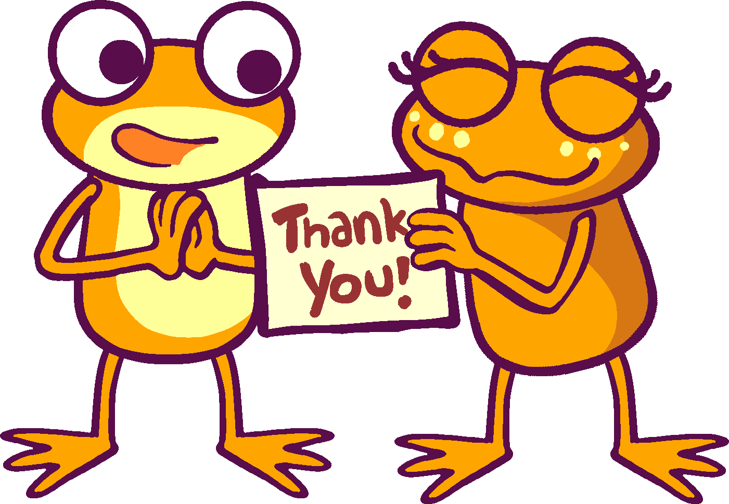
Skills Required
Self-management
Self-awareness
Communicate clearly
Collaborate on structured tasks
Show sensitivity to others’ views and ideas
Understand how to create consensus
Use active listening and speaking skills
Positively support the work of others

Slide 8
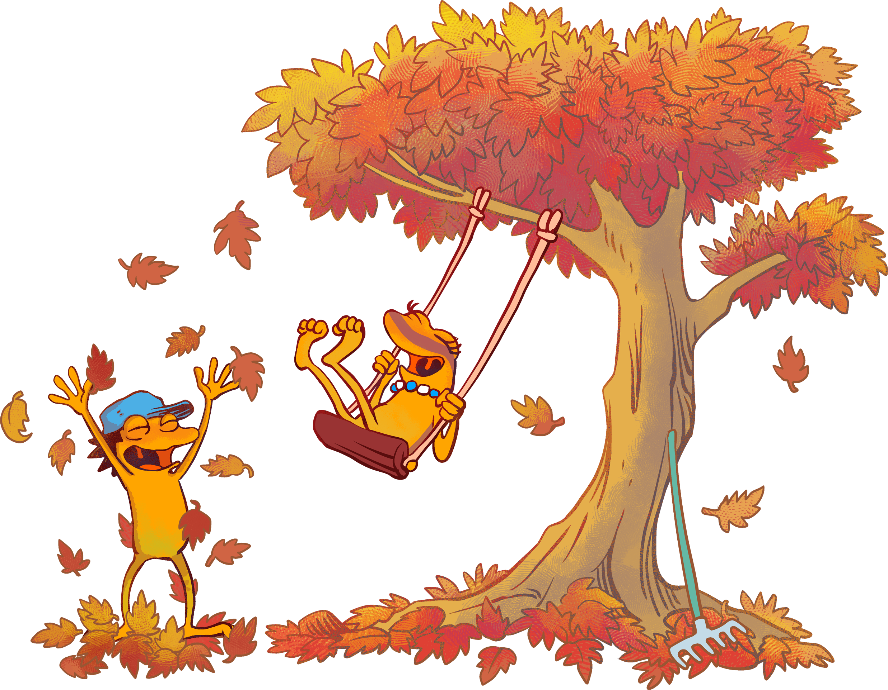
Are there times in your life when it’s easier to reflect than others?

Slide 9
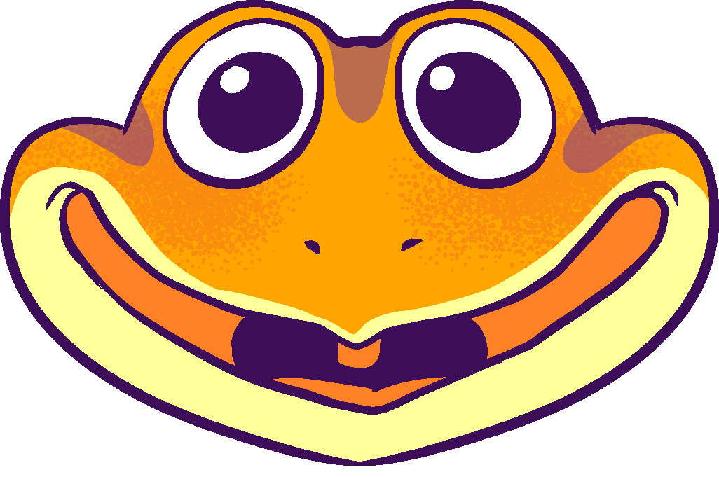
Thoughts on Reflection
When we reflect back, it’s important to be self-aware.
Reflection is a tool we use as students to grow ourselves.
We have to think about what we have done, what we have said, and how it has changed our day.
We can think about the way these things have affected us and how they have affected others.
Notes:
When we reflect back, it’s important to be self-aware. Reflection can be a tool we use as employees or team members to grow ourselves. We have to think about what we have done, what we have said, and how it has changed our day. We can think about the way these things have affected us and how they have affected others. We are going to look back at the way our Gratitude Journal has impacted our day and our lives. Does anyone feel like they are happier, knowing they are spending time each day looking for the good at home and at work?

Slide 10
Connecting this Lesson to Our Work
What was your biggest learning regarding gratitudes as they connect to our work?
How did you feel about your work-life while reviewing your 21-day Gratitude Journal?

Slide 11
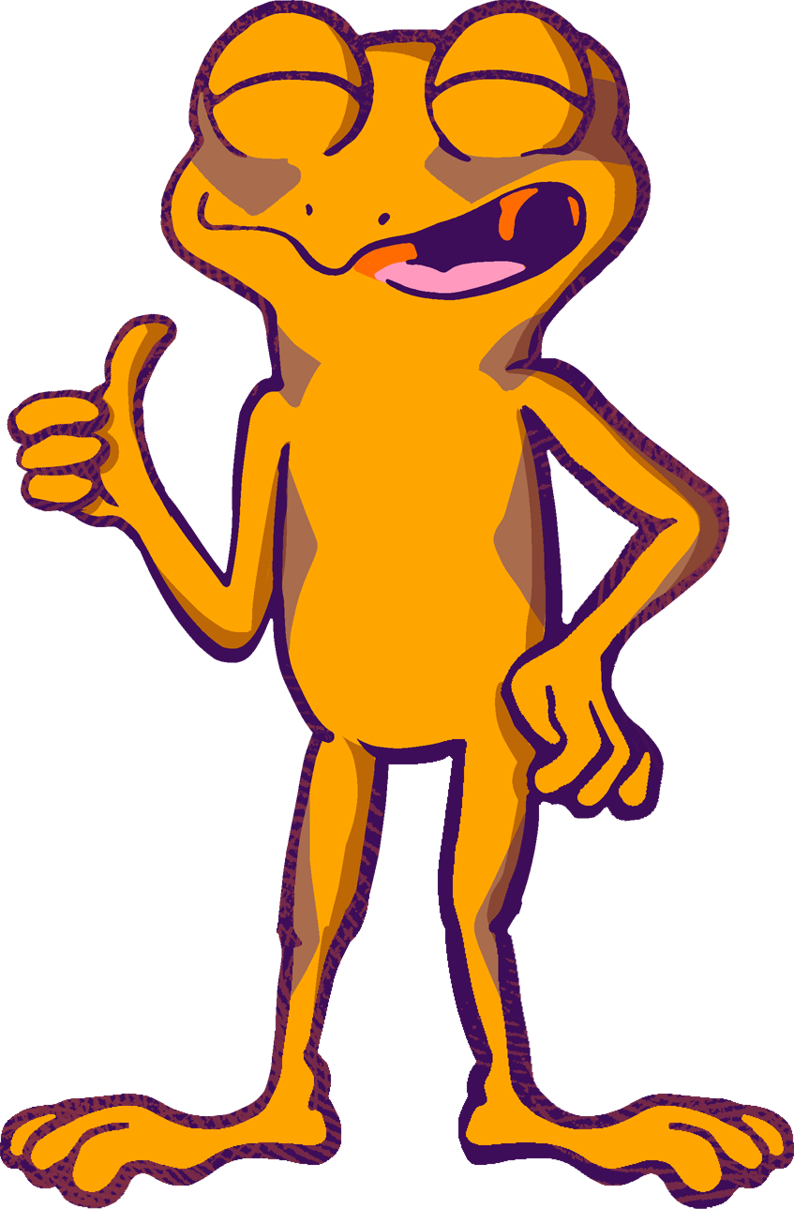
Action
Today, we will look back and reflect on the impact of our first Happiness Tactic, Gratitude.
Does anyone feel like they are happier, knowing they are spending time each day looking for the good in their day?
Notes:
(Participants may need to start their reflection time by physically looking at their journals). Today, we will look back and reflect on the impact of our first Happiness Tactic, Gratitude.

Slide 12
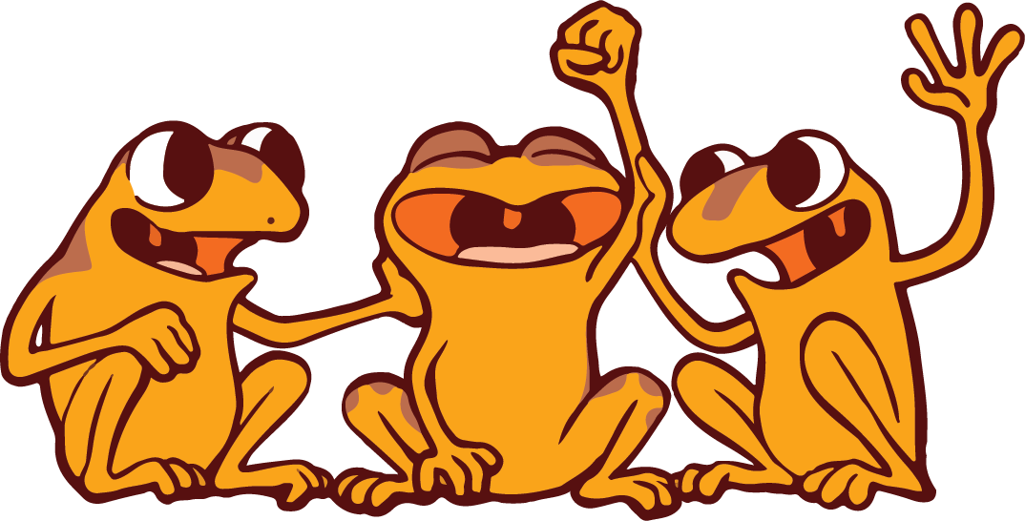
BONUS Questions
Was it difficult to reflect?
Do you think there was an overarching difference made?
What evidence do you have of a change?
Is this tactic something you can see yourself doing in the long run?
What is one thing you can do to make this tactic sustainable?

Slide 13
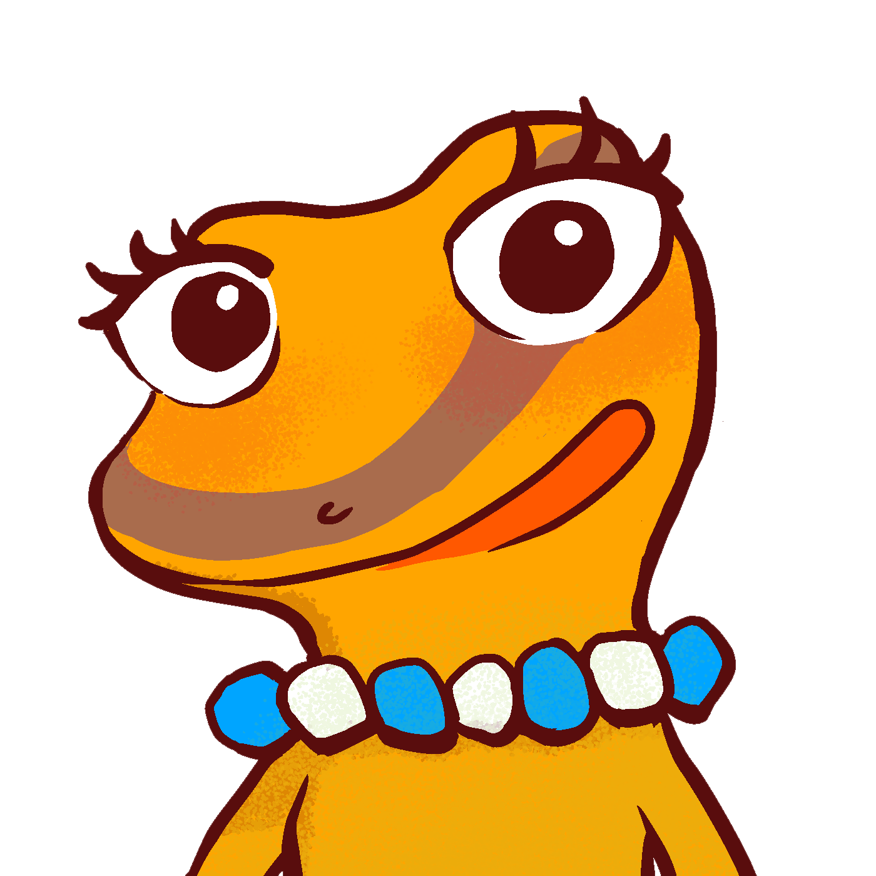
Our Class Playlist
Everybody, please list your three best songs that make you happy or grateful.
Let’s create our Orange Frog music playlist!
Just for Fun
Notes:
Feel free to give your own examples.

Slide 14
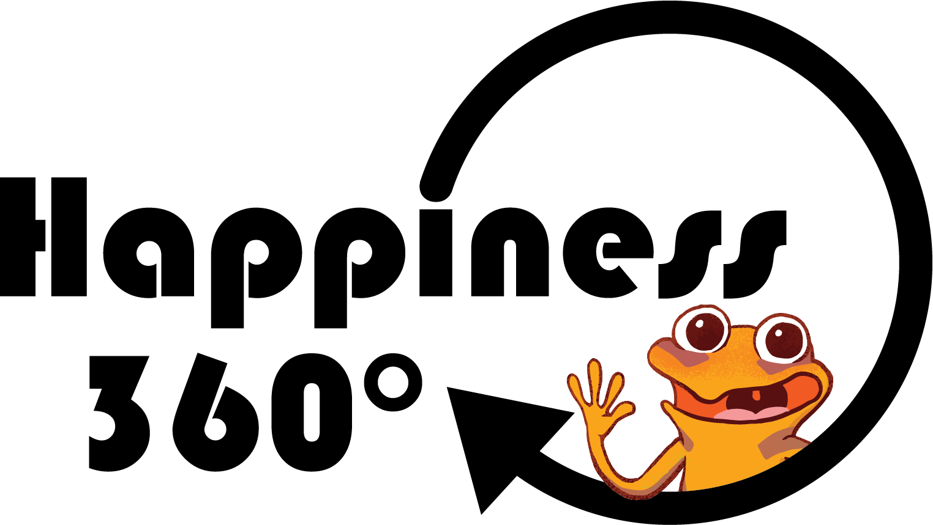
Weekly To-Dos
Make sure you’ve completed your 21-day Gratitude challenge. We’ll be moving onto a different tactic next week.
Share your gratitude experience with someone else at work or at home.

